Slide 1

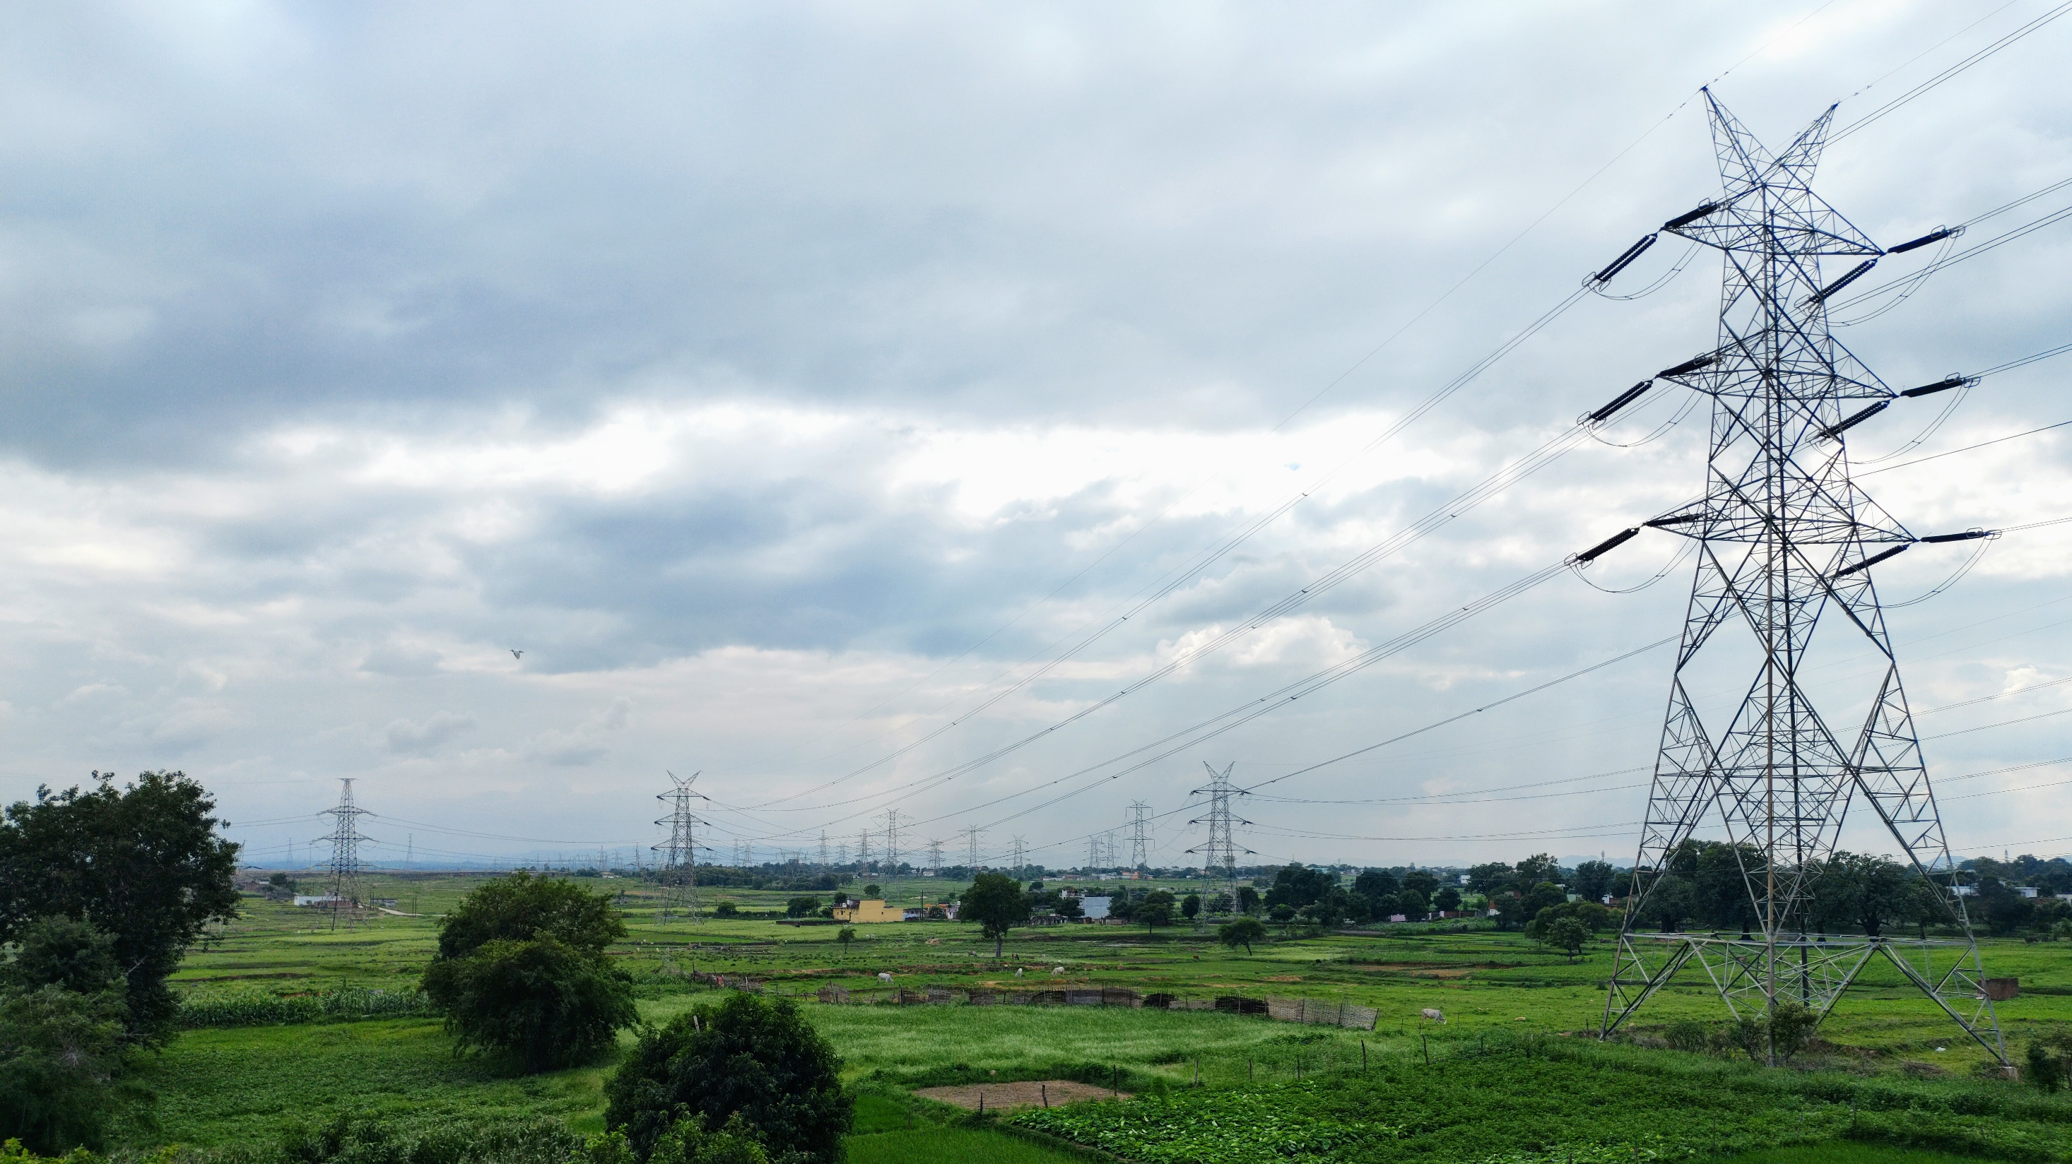
Modelling of Electrical
Power Systems

Slide 2


1) Initialize a three-phase salient pole synchronous generator (Load type PQ) with constant input mechanical power and field voltage. Show the output active power and rotor speed of generator. .
PROBLEM STATEMENT -1

Slide 3
Component Used.
Powergui.
Synchronous machine pu standard.
Bus bar(3-phase VI measurement).
Scope.
3-phase parallel RLC load.

Slide 4

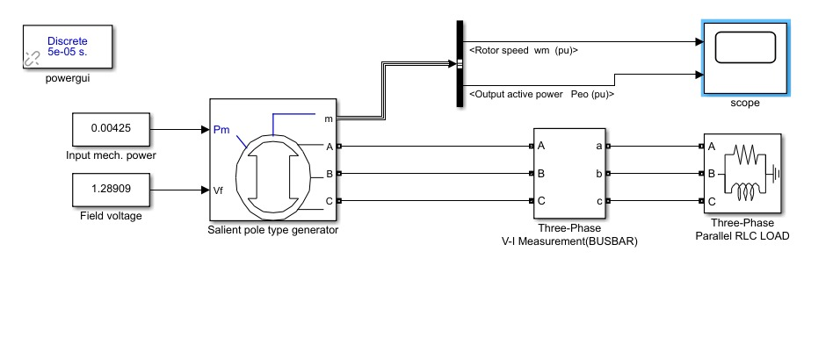
Block Diagram

Slide 5
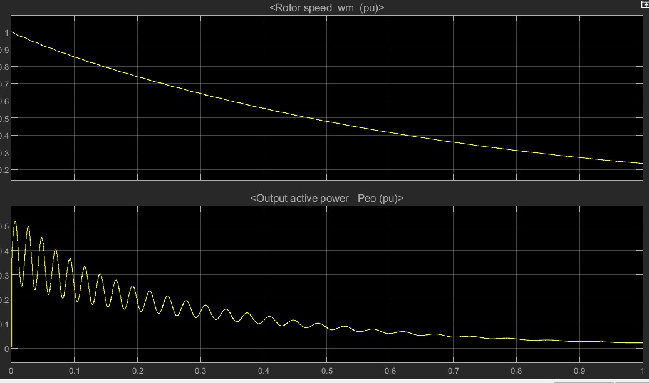
OUTPUT

Slide 6
2) Step-down the voltage using Y-delta transformer (13.8kV-2.4kV) through a busbar. Connect the busbar to grid (3-phase source) to make it infinite busbar.
PROBLEM STATEMENT -1

Slide 7
Y-delta connection
The main use of this connection is at the substation end of the transmission line where the voltage is to be stepped down
The primary winding is Y-connected with grounded neutral. The ratio between the secondary and primary line voltage is 1/ 3 times the transformation ratio of each transformer.
There is a 30° shift between the primary and secondary line voltages which means that a Y − ∆ transformer bank cannot be paralleled with either a Y − Y or a ∆ − ∆ bank. Also, third harmonic currents flows in the ∆ to provide a sinusoidal flux

Slide 8
Components Required
Powergui.
Y-delta transformer
3-phase source
Scope.
3-phase VI measurement bus bar

Slide 9
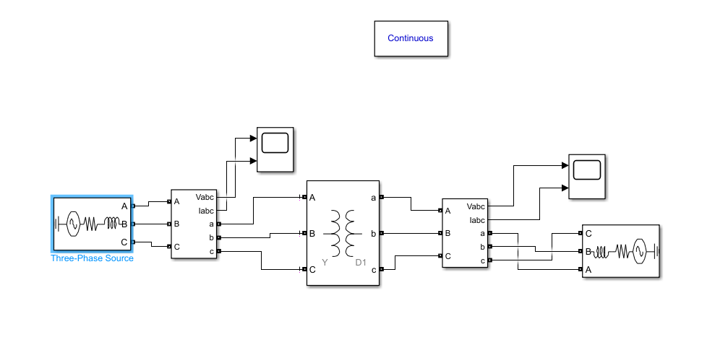
BLOCK DIAGRAM

Slide 10
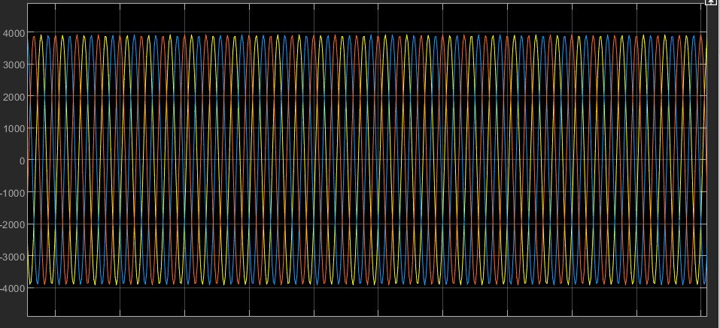
OUTPUT

Slide 11
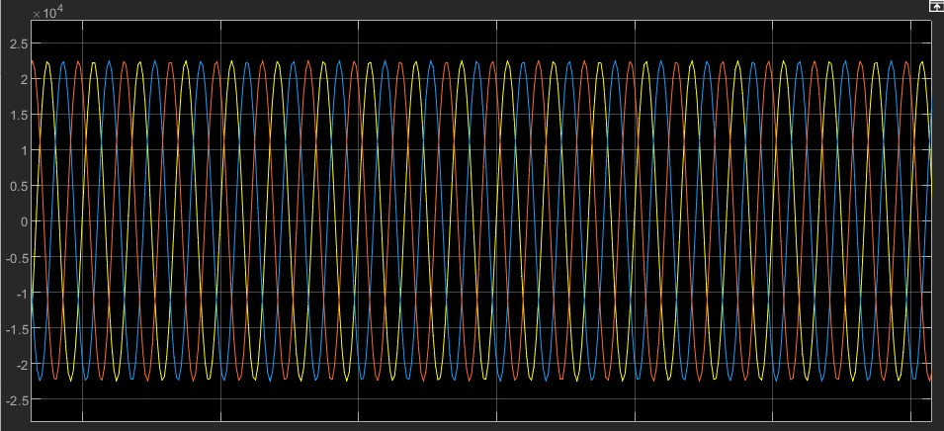
INPUT

Slide 12
3) Connect a three phase RLC load to the HV side of transformer. Also connect an induction motor (constant Torque input) and a three phase RL load to the LV side of the transformer. Show the rotor speed and active power of IM in scope.
PROBLEM STATEMENT -1

Slide 13
Components Required
Powergui.
Induction motor
Bus selector
Scope.
3-phase VI measurement bus bar
Parallel RLC branch
Y-Y transformer
3-phase power measurement

Slide 14
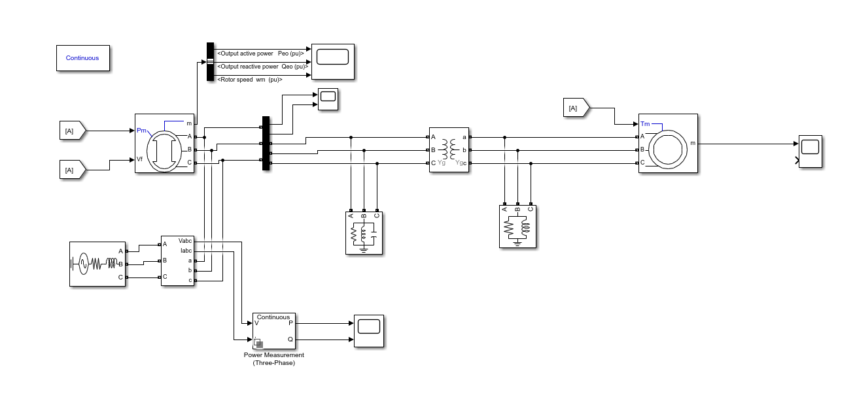
BLOCK DIAGRAM

Slide 15
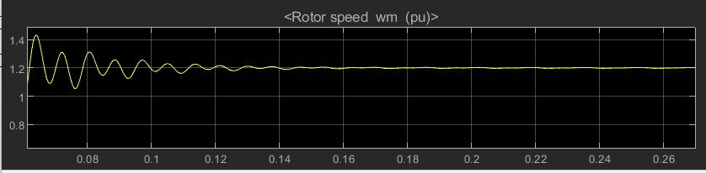
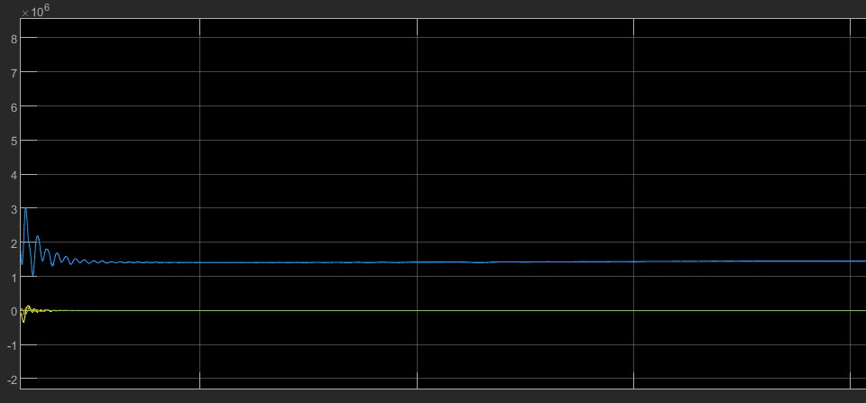
OUTPUT

Slide 16
4)Compute the load flows of the overall power systems (Must converge with high power factor).
PROBLEM STATEMENT -1

Slide 17
Components Required
Powergui.
Bus (3)
Load flow bus
Scope
Load
3-phase parallel RLC load
Slack

Slide 18
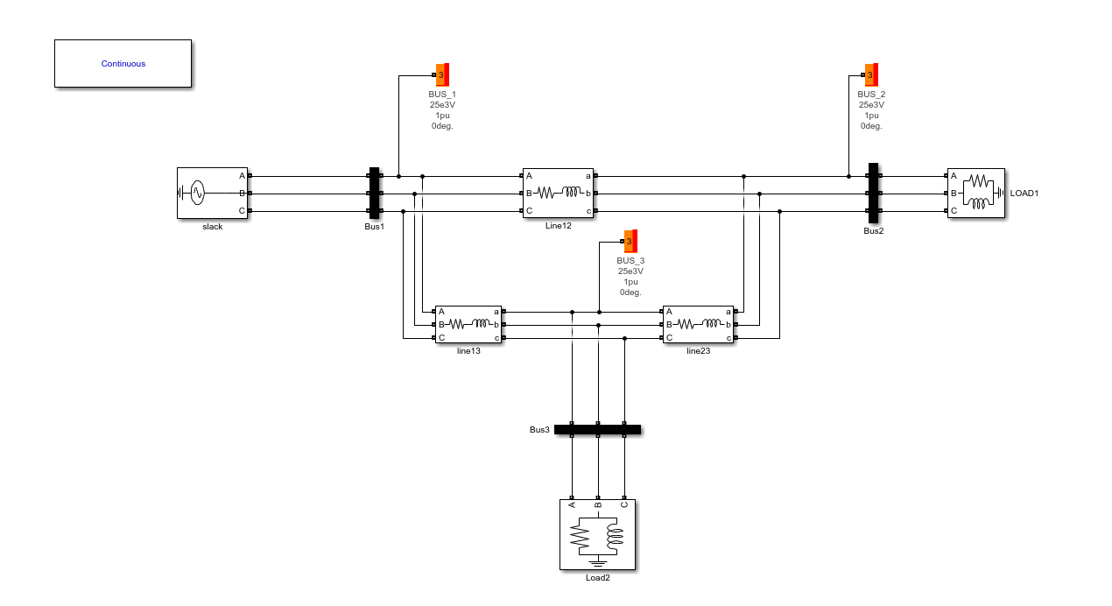
BLOCK DIAGRAM

Slide 19
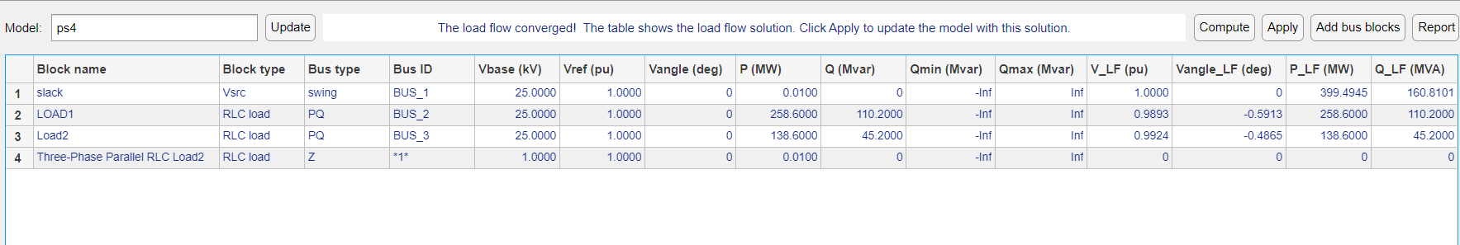
OUTPUT

Slide 20
5)Also connect a three-phase fault block at HV side of transformer to analyze both symmetrical and asymmetrical at proper switching times.
PROBLEM STATEMENT -1

Slide 21
Components Required
Powergui.
3-phase source
Delta-Y transformer
Scope

Slide 22
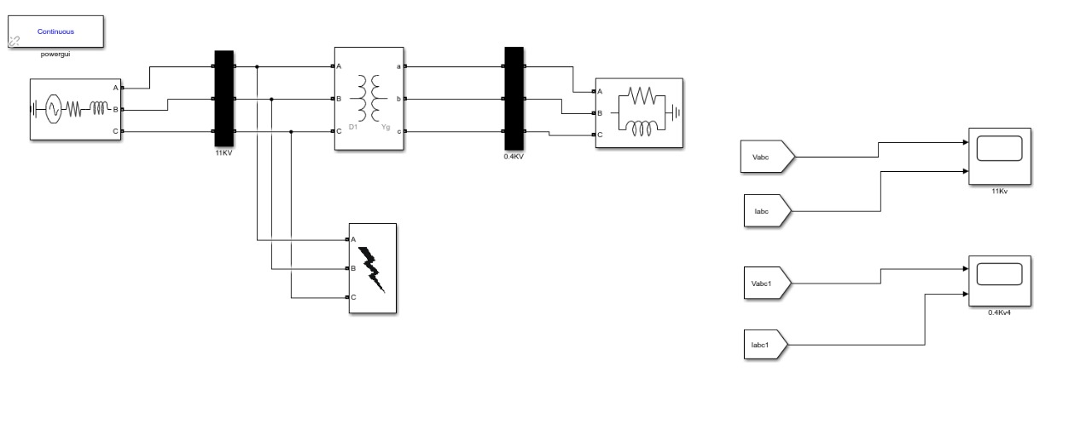
BLOCK DIAGRAM

Slide 23
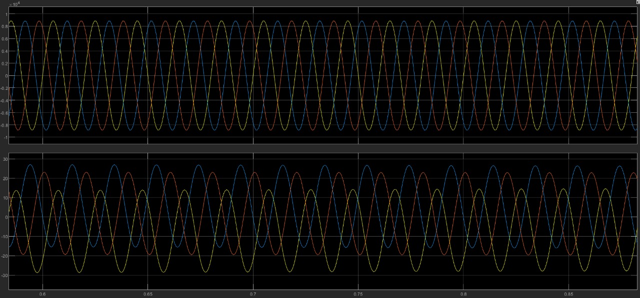
OUTPUT

Slide 24

3rd Problem statement
Modelling of MPPT Solar Charge Controller Model
[100 points]
a. Show the IV and PV characteristics of the selected PV array with constant temperature and radiation as input.

Slide 25
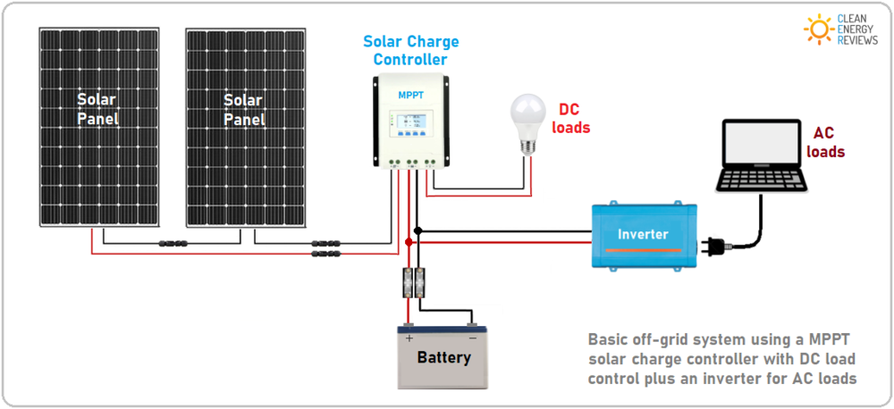
INTRODUCTION
An MPPT(maximum power point tracking)charge controller is a DC-DC converter that maximizes the efficiency of a solar system. It does this by optimizing the voltage match between the solar panel array and the batteries.
But what is a solar charge controller?
A solar charge controller, also known as a solar regulator, is basically a solar battery charger connected between the solar panels and battery. Its job is to regulate the battery charging process and ensure the battery is charged correctly, or more importantly, not over-charged. DC-coupled solar charge controllers have been around for decades and are used in almost all small-scale off-grid solar power systems.

Slide 26
Features of solar charge controller:
Protects the battery (12V) from overcharging
Reduces system maintenance and increases battery lifetime
Auto charged indication
Reliability is high
10amp to 40amp of charging current
Monitors the reverse current flow
Solar Charge
Controller
Simple 1 or stage controls
Maximum power point tracking(MPPT)
PWM(pulse width modulated)

Slide 27
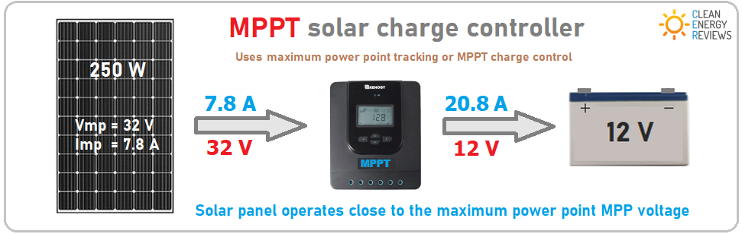
Maximum Power Point Tracking(MPPT)
A maximum power point tracker, or MPPT, is basically an efficient DC to DC converter used to maximize the power output of a solar system. The functioning principle of an MPPT solar charge controller is rather simple - due to the varying amount of sunlight (irradiance) landing on a solar panel throughout the day, the panel voltage and current continuously vary. The MPPT continually tracks and adjusts the PV voltage to generate the most power, no matter what time of day or weather conditions. Using this clever technology, the operating efficiency greatly increases and the energy generated can be up to 30% more compared to a PWM charge controller.

Slide 28
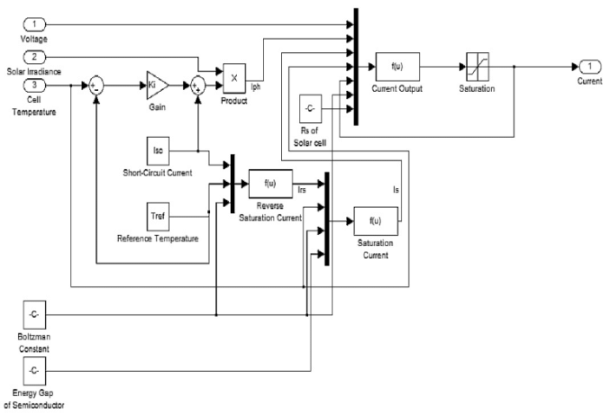
Modelling of MPPT Solar Charge Controller Model
(using MATLAB)
The PV Array block implements an array of photovoltaic (PV) modules. The array is built of strings of modules connected in parallel, each string consisting of modules connected in series.
The PV Array block is a five-parameter model using a light-generated current source (I_{L}), diode, series resistance (Rs), and shunt resistance (Rsh) to represent the irradiance- and temperature-dependent I-V characteristics of the modules.

Slide 29
Powergui(discrete)
PV array
MOSFET
Diode
Series RLC branch
Battery
Scope
COMPONENTS
REQUIRED-

Slide 30
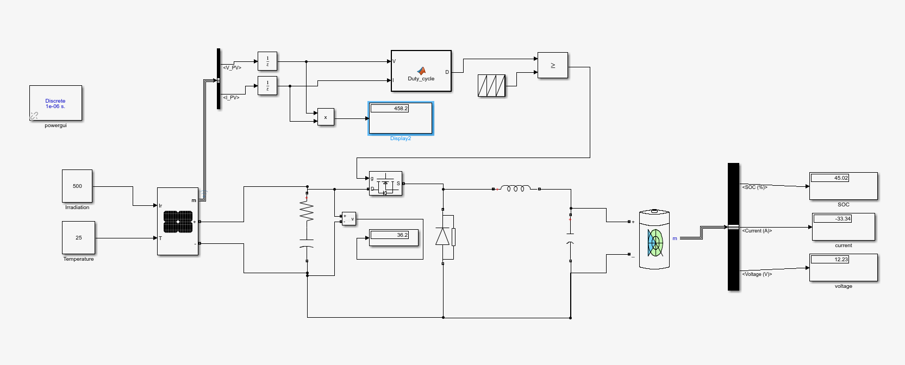
BLOCK DIAGRAM (MPPT)-

Slide 31
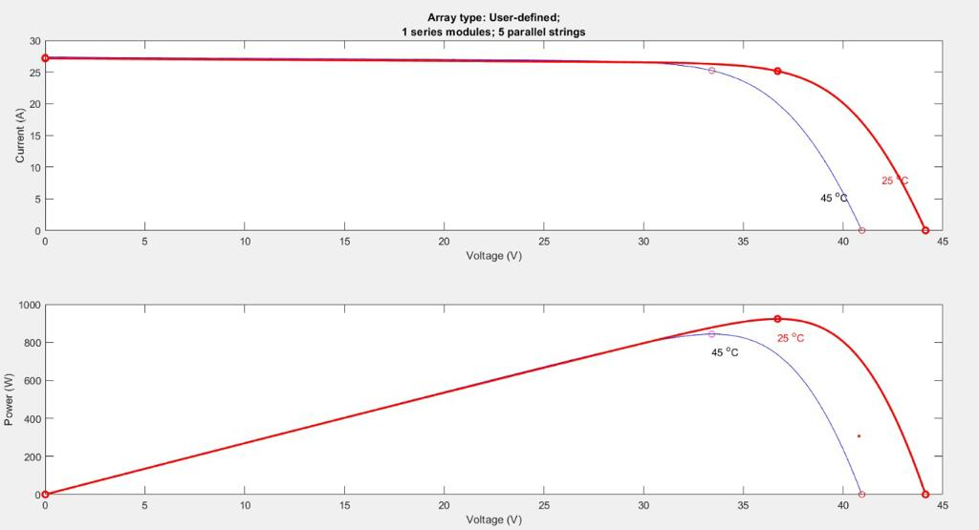
I-V and P-V characteristics

